Slide 1
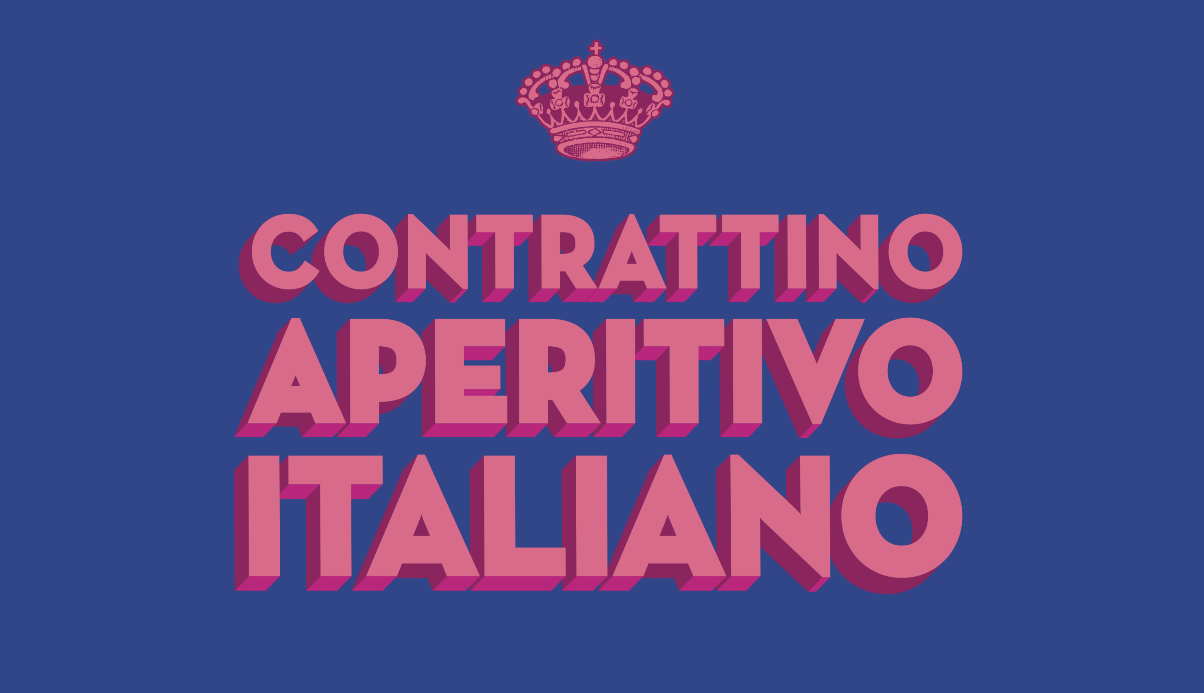


Slide 2

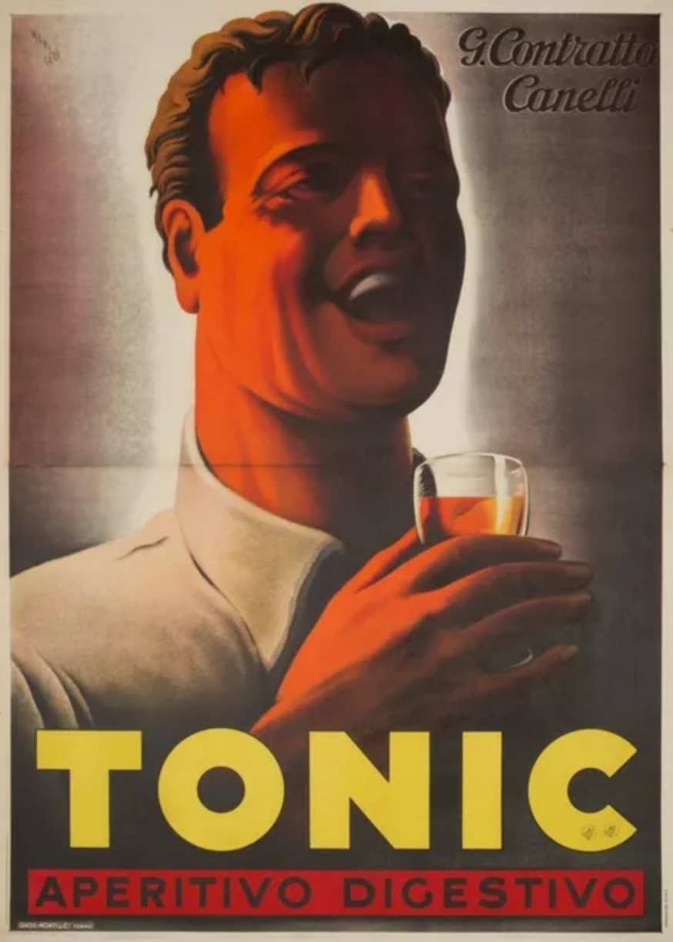
Premium organic Italian aperitif RTD from Contratto, historic producer founded in 1867.
Single‑serve 200 ml, 5.5% ABV – perfectly aligned with low‑ and moderate‑alcohol trends.
Ready to drink straight from the bottle or over ice; no cocktail skills required.
The historical inspiration – the 1930s Contratto Tonic Apertivo Digestivo

Slide 3




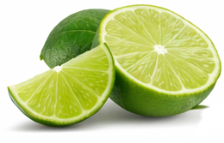
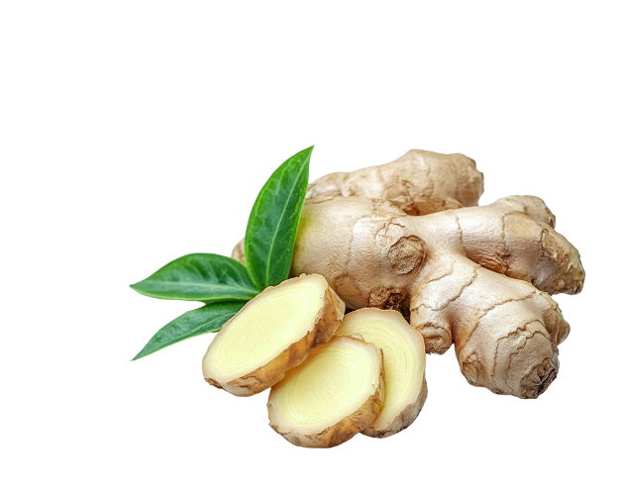

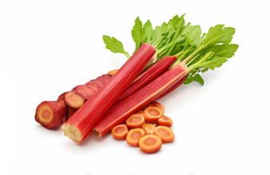
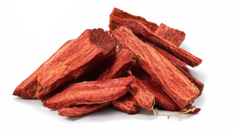
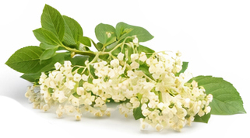
Pure water from the Alps
Natural color from
organic black carrots
Citrus notes from
organic oranges
and limes
Floral notes from organic
roses and elderflower
Spicy bitterness notes from
organic botanicals

Slide 4

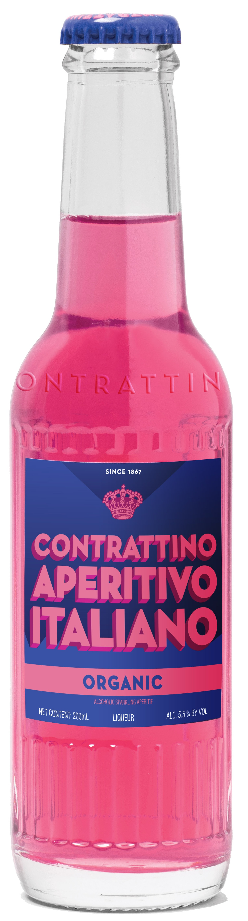
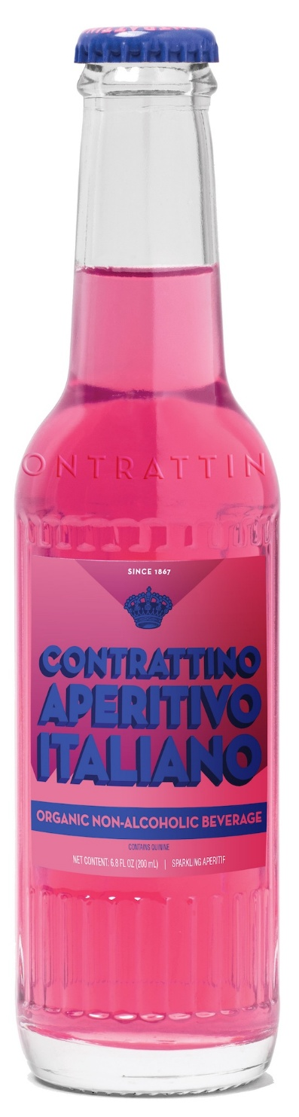
Contrattino is an organic Italian sparkling aperitif, ready‑to‑drink in a 200ml unique glass bottle, available in both 5.5% ABV and zero‑alcohol versions, inspired by classic Italian aperitivo culture.
5.5% abv non-alcoholic

Slide 5

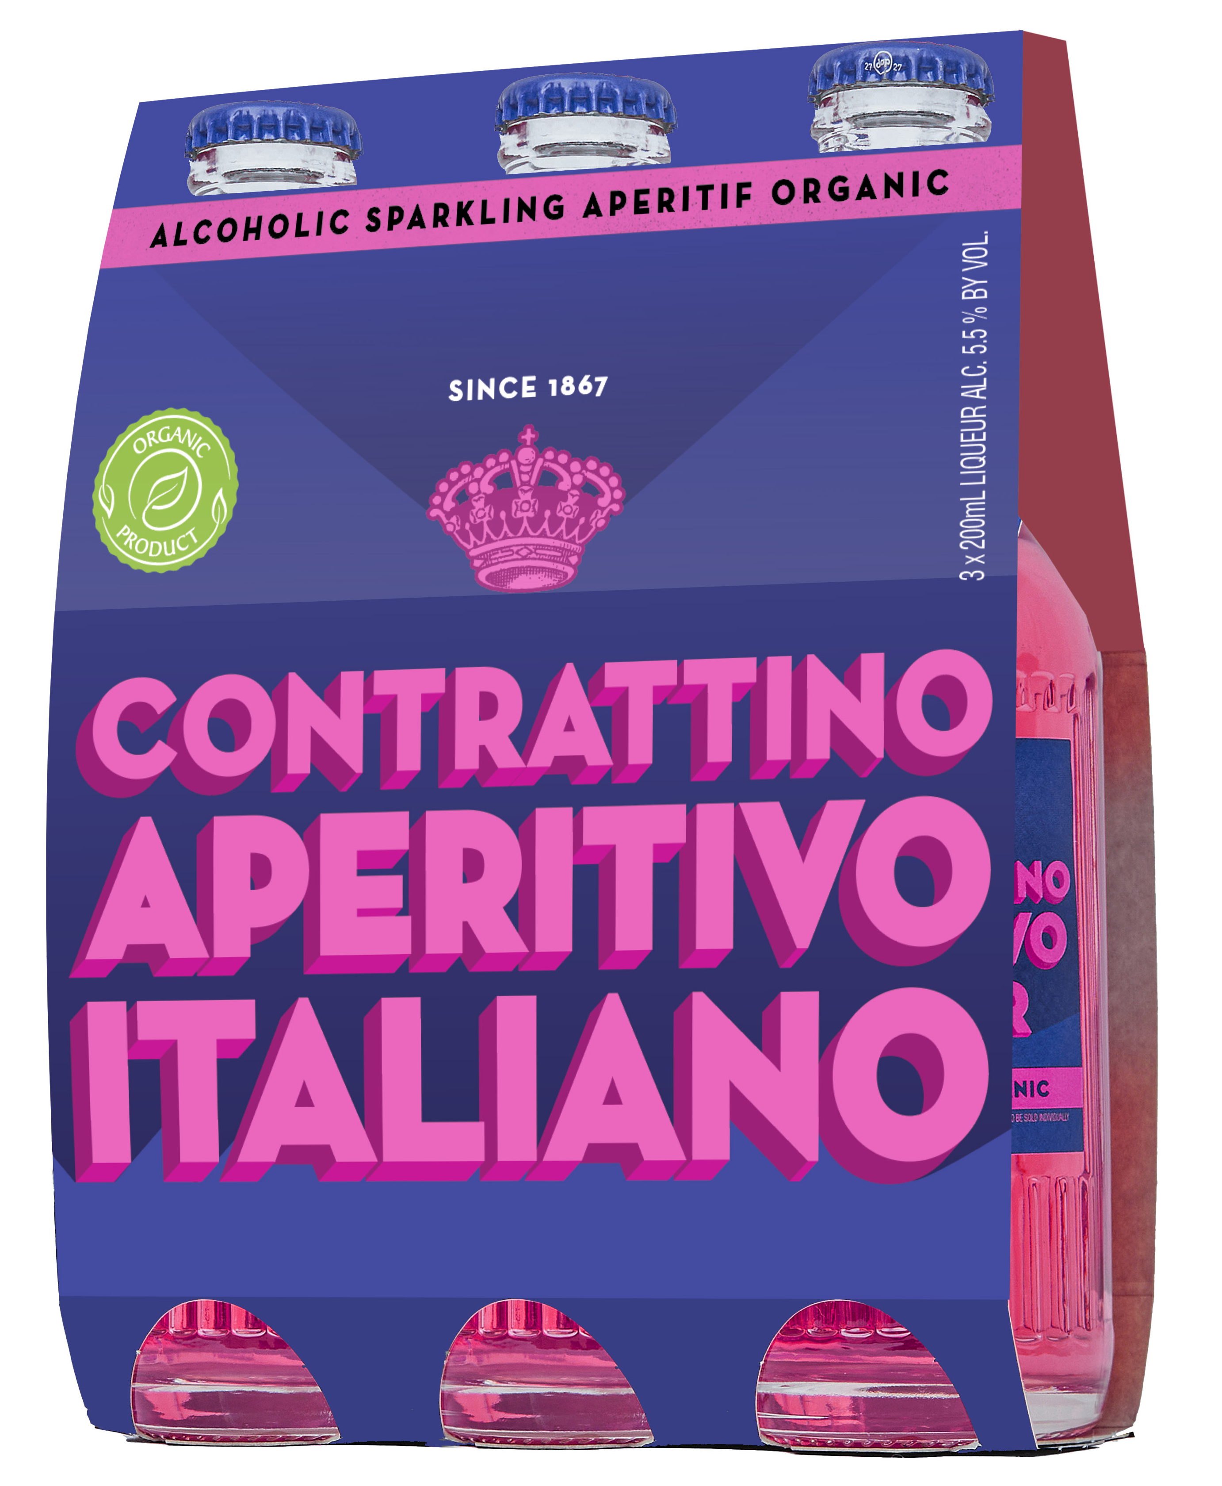
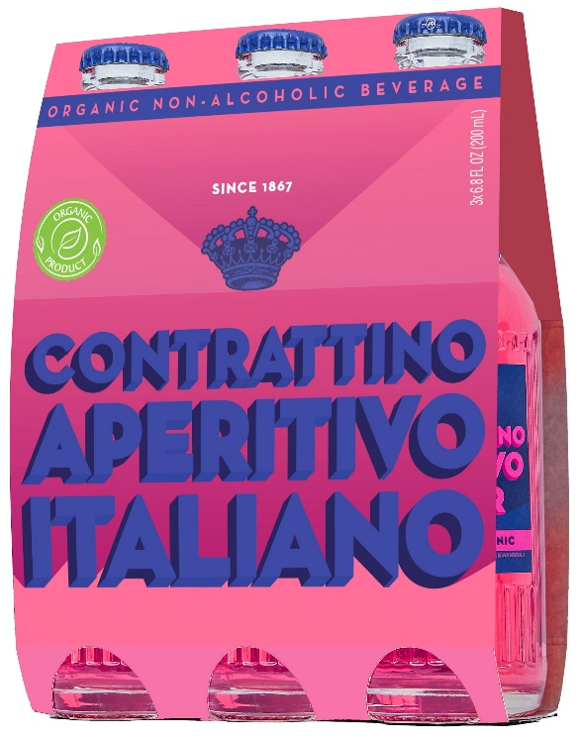
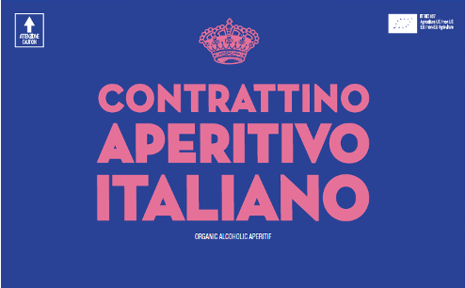
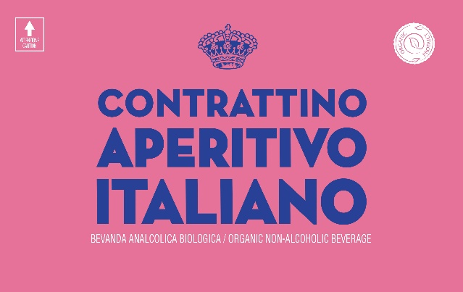
3-pack wrap
On‑premise: Italian and Mediterranean restaurants, cocktail bars, hotel mini-bar, wine bars and catering.
Off‑premise: specialty retail, upscale independents, chains with RTD sets, grab‑and‑go fridges near the register.
Perfect for individual servings, flights, happy hour, spritz programs, and RTD end‑caps.
Lunch and brunch, corporate events, health and wellness-focused venues and all accounts with interest in NA clientele.
5.5% abv non-alcoholic
Box

Slide 6

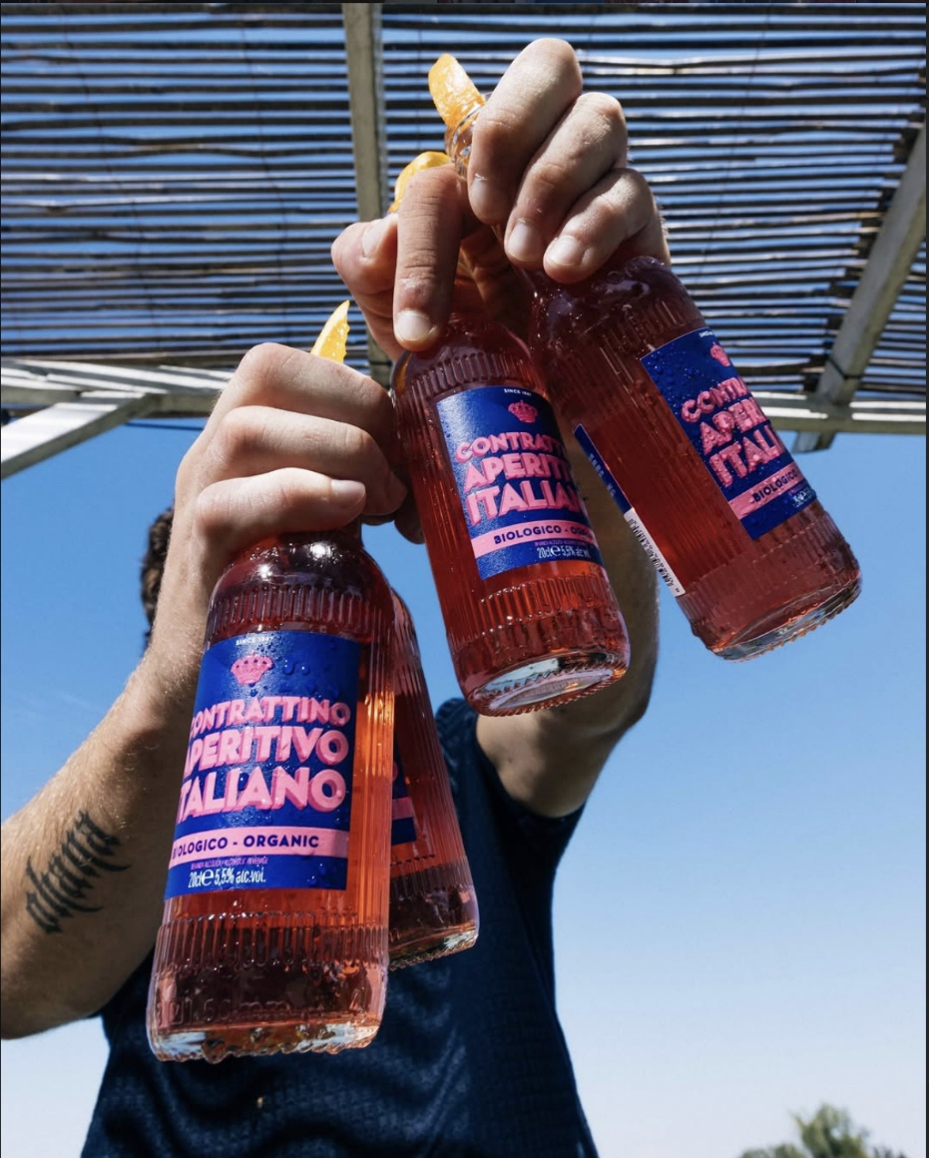

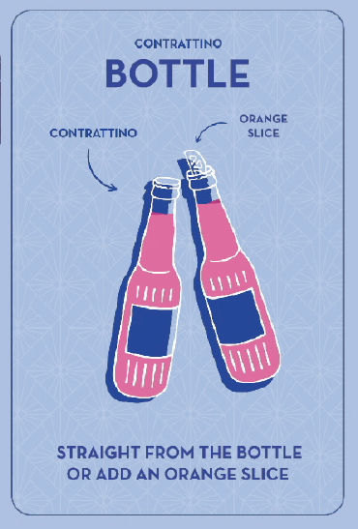
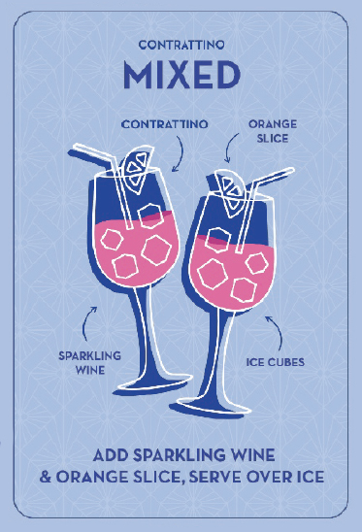
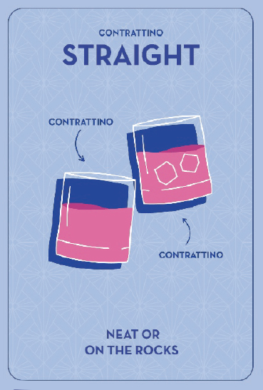
Serve well chilled, straight from the bottle or in a wine glass
over ice.
Optional: top with a splash of soda water and an orange
slice for a “signature spritz.”
Zero prep, consistent serve every time, easy to execute even with
limited staff.

Slide 7

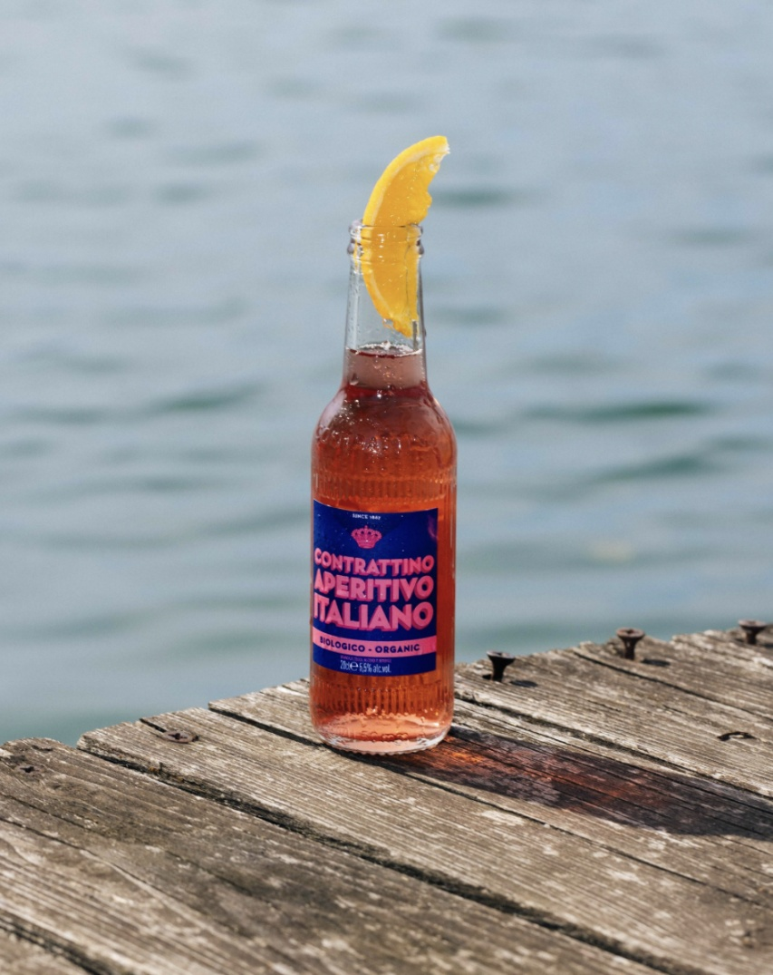
•Organic product line with more than 30 Italian botanicals and a clean ingredient story.
•Authentic Italian brand from a historic house, not a made‑up “Italian‑style” label.
•Two versions: 5.5% ABV and zero‑alcohol, under one recognizable brand.
•Eye‑catching custom glass and Art Déco label + colorful packaging– easy yes once buyers see it.
•Very simple serve (no training, no recipes), for both
•RETAIL SCANNING – 3 separate UPCs (bottle, 3pk, case)

Slide 8
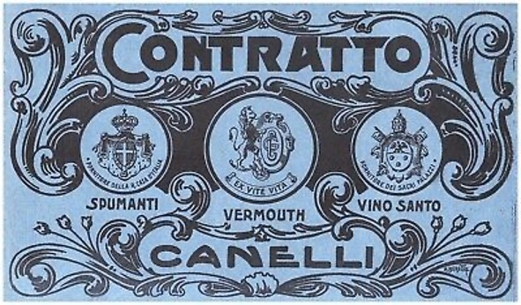
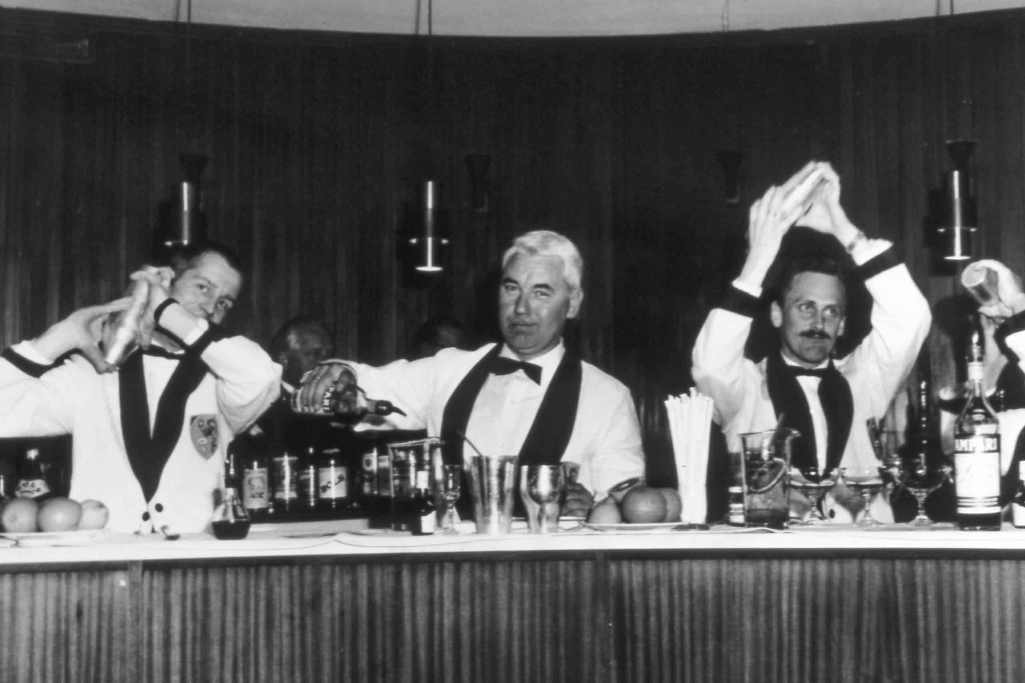
Key selling stories
Direct line back to Contratto’s original Aperitivo Tonic (1936) – an authentic Italian RTD long before the category had a name.
Connects the golden age of Italian aperitivo to today’s convenience‑driven, low‑ABV consumer.
Gives accounts a true Italian alternative to mass RTD brands, with stronger identity and story for menus and social media.

Slide 9


